Slide 1
ET Tutorial
Nodal Analysis

Slide 2
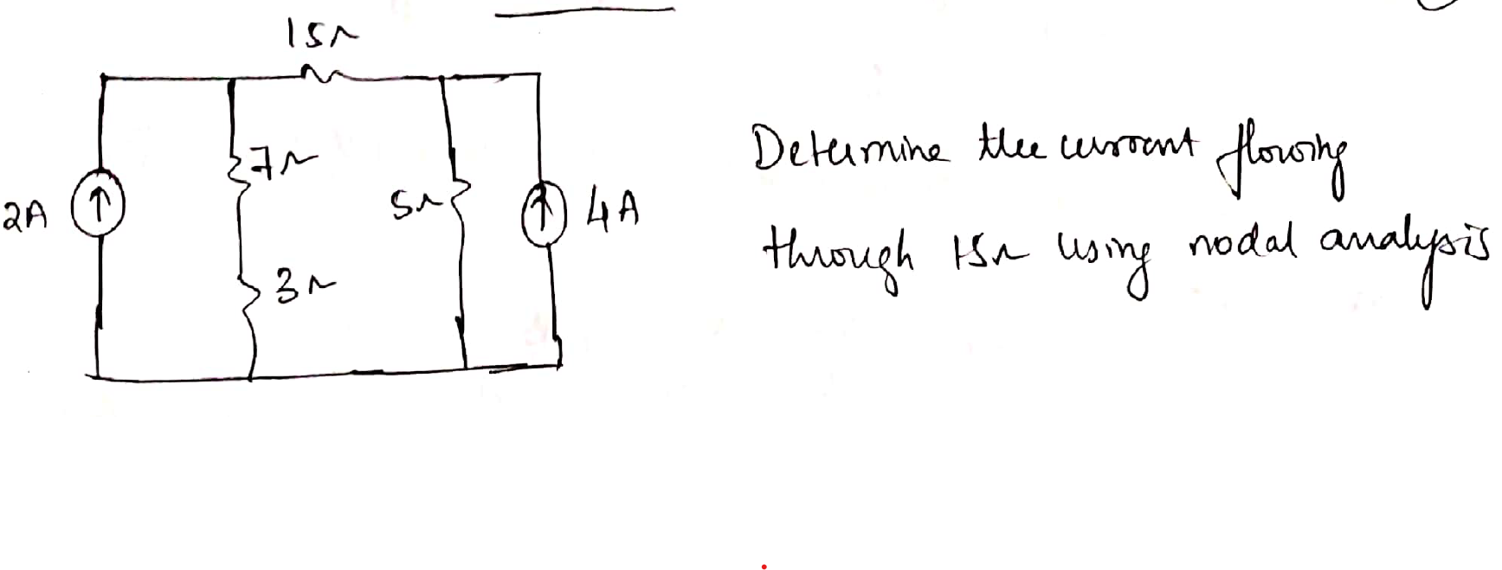
Question 1
Ans: 0 A

Slide 3
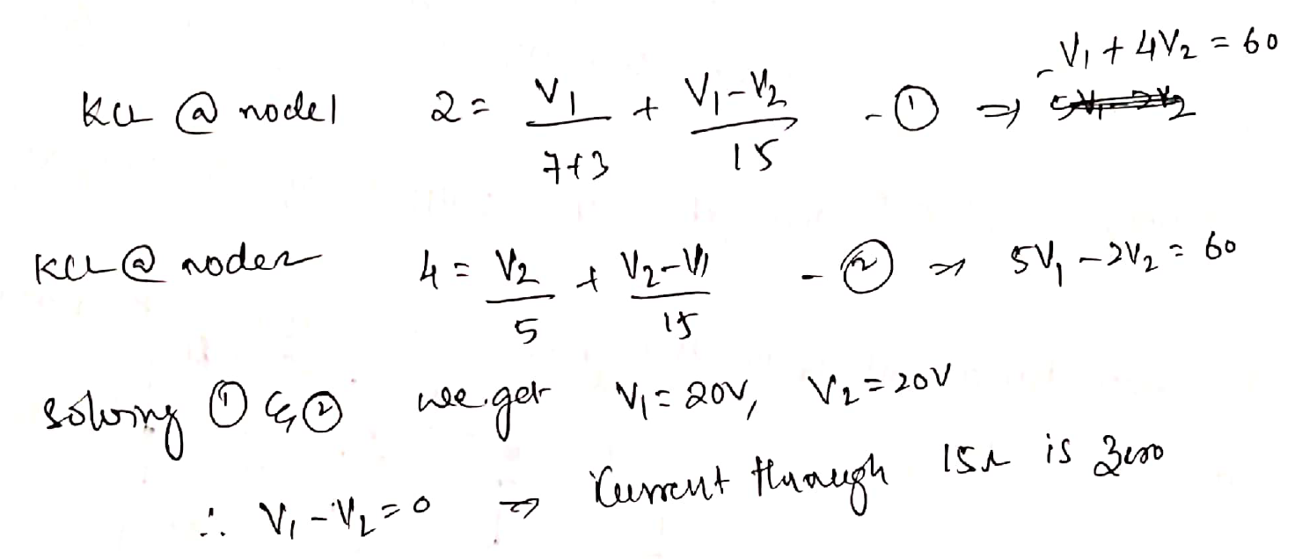

Slide 4
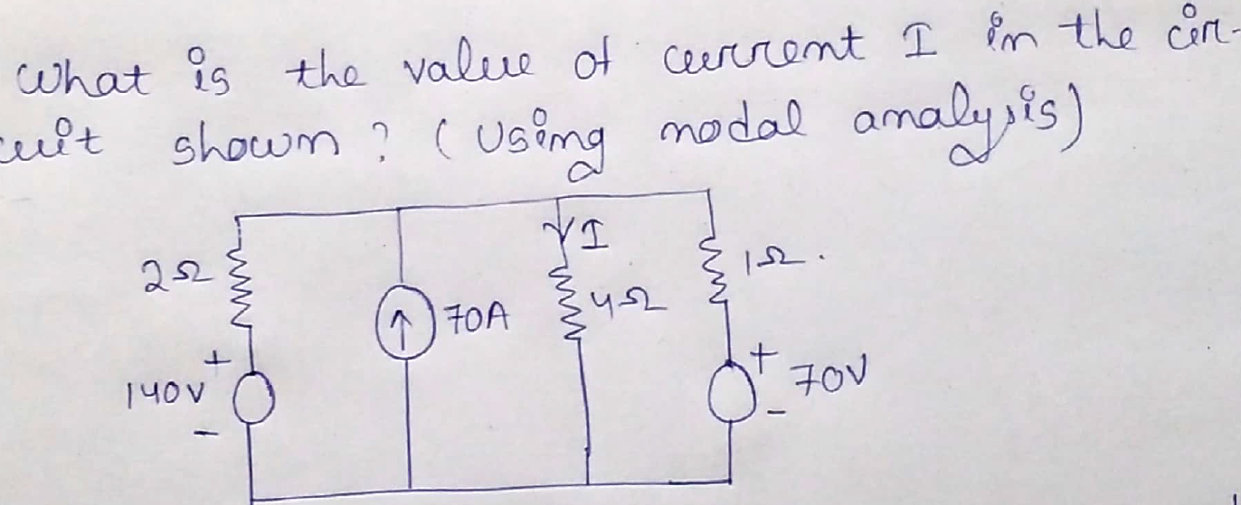
Question 2
Ans: I = 30A

Slide 5
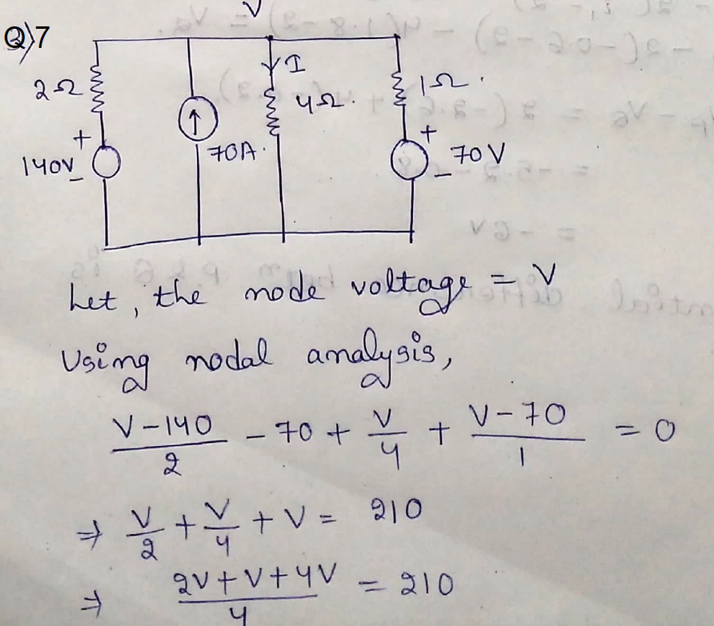
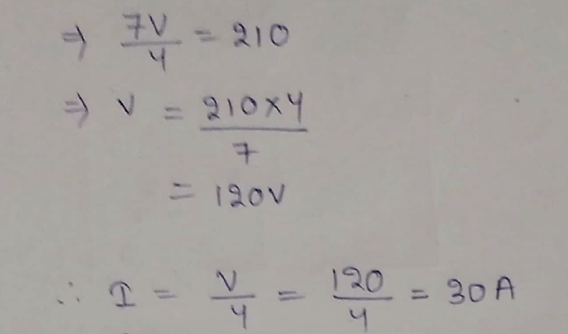

Slide 6
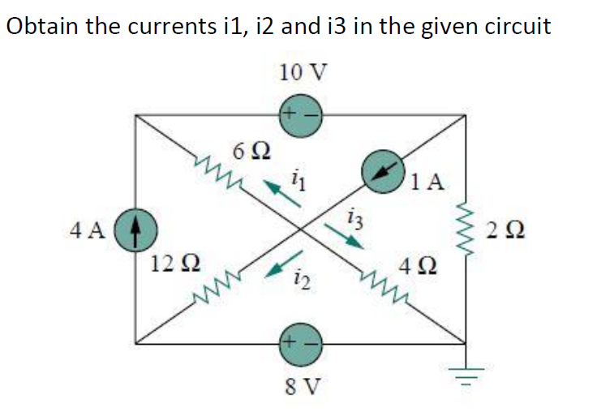
Question 3
Ans: i1 = -1A, i2 = 0 and i3 = 2A

Slide 7
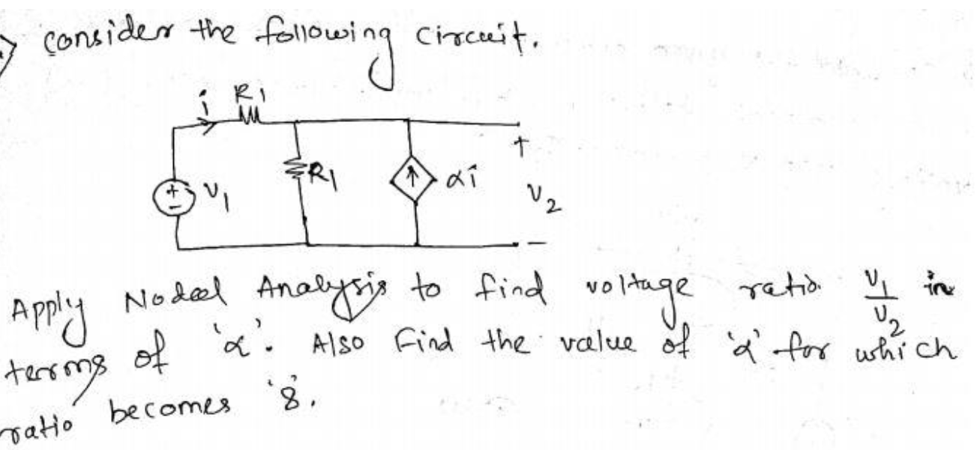
Question 4
Ans: α = -6/7

Slide 8
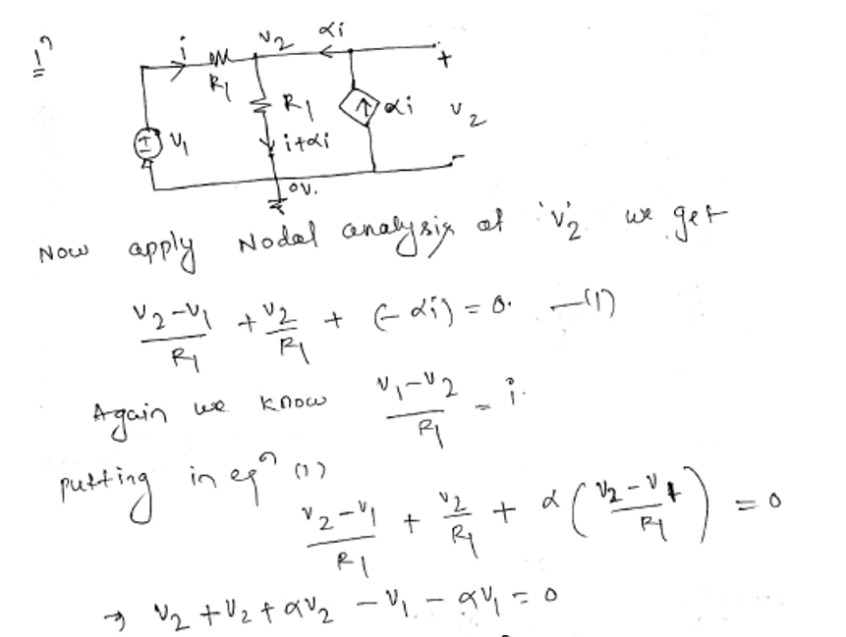
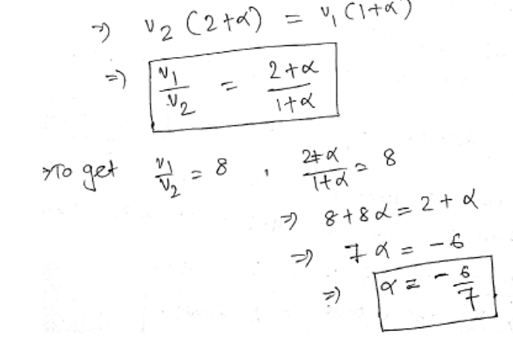

Slide 9
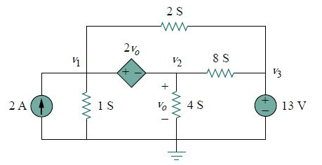
Question 5
Determine voltages v₁, v₂ and v₃ in the circuit using nodal analysis.
Note that in the circuit given above S is the unit of conductance.

Slide 10
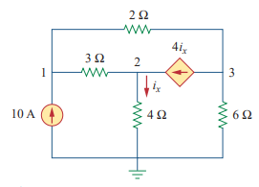
6. Find the voltages at the three nonreference nodes in the circuit

Slide 11
6. Find the voltages at the three nonreference nodes in the circuit
V1=80 V, v2=64 V, v3=156 V

Slide 12
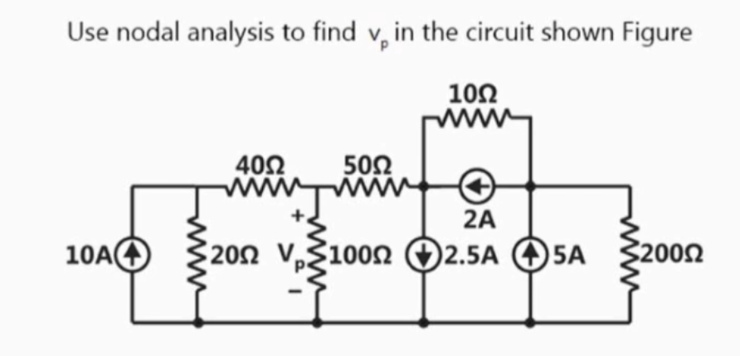
7.

Slide 13
7.
V_{P}= 171.638 V

Slide 14
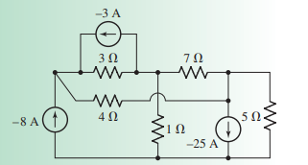
8.Determine the nodal voltages for the circuit

Slide 15
8.Determine the nodal voltages for the circuit
V1= 5.412V
V2= 7.736V
V3=46.32V

Slide 16
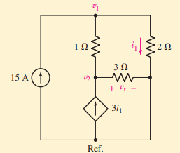
9. Determine the power supplied by the dependent source

Slide 17
9. Determine the power supplied by the dependent source
P = 4.5kW

Slide 18
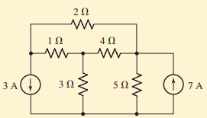
10. compute the voltage across each current source

Slide 19
10. compute the voltage across each current source
v3A = 5.235 V;
v7A = 11.47 V

